Slide 1

Module 2:
How People Learn
A professional learning program for informal science educators
Session 2:
Learner’s prior knowledge
Notes:
This material is based upon work supported by the National Science Foundation (DRL-1612515). Any opinions, findings, and conclusions or recommendations expressed in this material are those of the authors and do not necessarily reflect the views of the National Science Foundation.

Slide 2

How People Learn
Learning is making connections between past and new experiences, knowledge, skills, beliefs, etc., and building mental models to organize and understand.
The opportunity to talk with others is critical for learning.
Learners build their knowledge through interactions, conversations, and experiences.
Notes:
Image credit: https://pixabay.com/en/post-it-sticky-note-note-memo-150262/

Slide 3
Module 2. Session 2
Learners’ Prior Knowledge
Session objectives:
Discuss the role of prior knowledge in learning.
Engage in a learning experience and reflect on how prior knowledge influenced that experience.
Discuss the major research perspectives regarding prior knowledge and conceptual change.
Determine how educators in informal settings can activate and connect to learners’ prior knowledge in their practice, given the unique and diverse nature of their interactions.

Slide 4
Learners’ Prior Knowledge
Prior knowledge exists not only at the level of “concepts,” but also at the levels of perception, focus of attention, procedural skills, modes of reasoning, and beliefs about knowledge.
Learners’ prior ideas, their “common sense,” and “everyday thinking” are intelligent and useful for them. If those ideas aren’t engaged when we teach, learners often dismiss the ideas from the learning experience as irrelevant.
Notes:
Image credit: https://pixabay.com/en/post-it-sticky-note-note-memo-150262/

Slide 5

Think Pair Share
Learners’ Prior Knowledge
What are your purposes for activating learners’ prior knowledge?
What are your assumptions about learners’ knowledge based on this information?
What do you do with this information?
Notes:
Image credit:
https://pixabay.com/en/bulb-electricity-halo-idea-light-1293332/
https://pixabay.com/en/pear-brown-fruit-food-color-fresh-747664/
https://pixabay.com/en/share-connect-icon-880816/

Slide 6
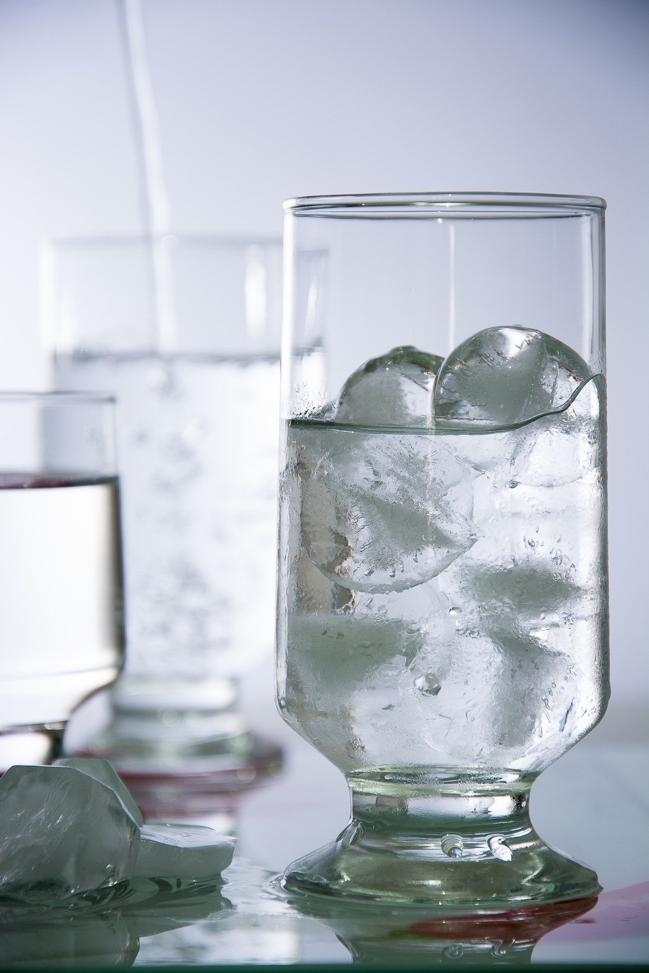
Hands-on
Ice Cubes Investigation
Will ice cubes melt faster in fresh water or salt water?
Think about the experiment.
Write your prediction, include a rationale for why you think that.
Notes:
Image credit: https://pixabay.com/en/water-ice-glass-liquid-663100/

Slide 7
Instructions
Divide the ice cubes evenly between the two cups of water—and then be sure NOT to disturb or stir the cups.
Your task is to do the investigation as a small group and come up with an explanation for what you observe.
Continue to discuss your predictions and rationale as you make careful observations of the cups and melting ice.
You have about 10 minutes for this part of the activity.

Slide 8

Gather more evidence
How do these new observations with the food coloring help point to the cause for why ice cubes melted faster in fresh water?
What is the relationship between the results and your prior knowledge? What knowledge, ideas, assumptions, and experiences did you draw on during the investigation?
Notes:
Image credit: https://pixabay.com/en/watercolour-paint-dripping-ink-1755724/

Slide 9
Whole-Community Discussion
Which ice cubes melted the fastest?
Why do you think that was happening?
Notes:
Image credit: https://pixabay.com/en/water-ice-glass-liquid-663100/

Slide 10

Turn & Talk
Ice Cubes Investigation
What is your explanation now for why the ice cubes melted faster in the fresh water?
Notes:
Image credit: https://pixabay.com/en/chat-discussion-meeting-talk-23713/

Slide 11

Table Talk
Hands-on Debrief
What ideas did you discuss at your table while you made predictions and explanations about which ice cubes would melt fastest?
What prior knowledge were you accessing to make your prediction?
Notes:
Image credit: https://pixabay.com/en/meeting-conference-people-table-152506/

Slide 12
Ice Cubes Explanations: Prediction
I predict the ice will melt faster in salt water because:
Salt causes ice on roads to melt.
Salt affects the freezing point of water.
There are differences in the specific heat capacity of salt water and fresh water.
The salt water has dissolved NaCl in it which causes the molecules to be in greater motion than the freshwater molecules, and that will cause the ice to melt (be eroded away).
D=M/V

Slide 13
Ice Cubes Explanations: Prediction
I predict the ice will melt faster in fresh water because:
Adding salt makes things colder – that’s why you use it when making ice cream and why you put it in coolers of beer.
Salt affects the freezing point of water.
The ice will be more buoyant in salt water than in fresh water, so the ice cube will have less surface area in contact with liquid in the saltwater cup.
Fresh water in the cup is the same as the fresh water melting off the ice cube, so it can melt more easily.

Slide 14
Ice Cubes Explanations: Analysis
Lacking reasoning. Learners proffer concept (e.g., heat capacity) or formula (e.g., D=M/V), or use technical language, but do not provide reasoning to explain how those ideas are connected to the phenomenon.
Flawed understanding. Learners provide a concept or formula, but the elaboration reveal learners may not really understand the concept.
Hindered by prior knowledge. Learners use prior experience with salt and ice as analogous examples to generate an explanation for this experiment. But the examples distracted them from noticing to what was happening in the cups.

Slide 15
Ice Cubes Explanations:
After seeing results
Like dissolves like. Fresh water in the cup is the same as the fresh water melting off the ice cube, so it can melt more easily.
There are density differences between the freshwater ice cube and the cup of salt water; salt water is denser than fresh water, even really cold fresh water. This sets up two stratified layers: cold fresh water trapped on top of room-temperature salt water.

Slide 16
Ice Cubes Explanations:
After seeing results
Because of density differences, the freshwater layer made up of a small volume of icy cold fresh water that melts off the ice cube is stuck on top of the larger volume of room-temperature salt water. There is less volume for the cold fresh water to spread out, so it keeps the ice cube enveloped in very cold, just-melted water. In the freshwater cup, the cold, just-melted fresh water sinks to the bottom and effectively displaces the room-temperature water in a continual circulatory effect (convection current); the remaining ice cube is surrounded by less cold water.

Slide 17
Ice Cubes Explanations:
After seeing results
I was right. The ice will be more buoyant in salt water than in fresh water, so the ice cube will have less surface area in contact with liquid in the saltwater cup. That will make the ice cubes melt more slowly in the saltwater cup.

Slide 18
More on Prior Knowledge
Humans are goal-directed agents who actively seek information. We have a range of prior knowledge, skills, beliefs, and concepts that significantly influence what we notice about the environment and how we organize and interpret it.
This prior knowledge, in turn, affects our abilities to remember, reason, solve problems, and acquire new knowledge.
Having errors in our understanding is an inescapable part of learning.
Notes:
Image credit: https://pixabay.com/en/post-it-sticky-note-note-memo-150262/

Slide 19
So, is learning simply a matter of replacing those inaccuracies with the correct “answers”?
We know that just telling learners that their ideas, beliefs, and understandings are wrong doesn’t work.
Why not?

Slide 20
Reading Partner Research Discussion
Prior knowledge & Conceptual change
3 Conditions and 3 Grain Sizes of Knowledge
Addressing Misconceptions
Form groups of 4.
Pair up with someone in your group.
Each pair Read one topic.
Talk with your partner:
  What does each idea mean?
  How do the ideas relate to what you already know?
Share & Discuss in your group:
  What is your topic about?
  What questions came up?
  What are connections between the topics?
Be prepared to share the big ideas from group discussion.

Slide 21

Whole-Community Discussion
Prior knowledge & Conceptual change
What ideas generated interesting/perplexing/controversial/excited discussion within your group?
What connections did you notice across the topics?
  What new connections emerged that broadened your thinking in new directions?
Notes:
Image credit: https://pixabay.com/en/group-team-feedback-confirming-1825509/

Slide 22
Summary of Ideas
Prior Knowledge and Conceptual Change
Three conditions of prior knowledge. Learners’ prior knowledge about concepts we teach may be incomplete, misconceived, or missing altogether.
Three grain sizes of knowledge. Our knowledge can be conceived of as individual belief, mental model, and category. We don’t advance from one grain size to the next as we learn. They exist simultaneously.
Wrong answers are complicated. There are many sources for learners’ inaccuracies.
Nudging conceptual change. We cannot eradicate misconceptions. It requires repeated exposure and many opportunities to engage with the concepts.

Slide 23
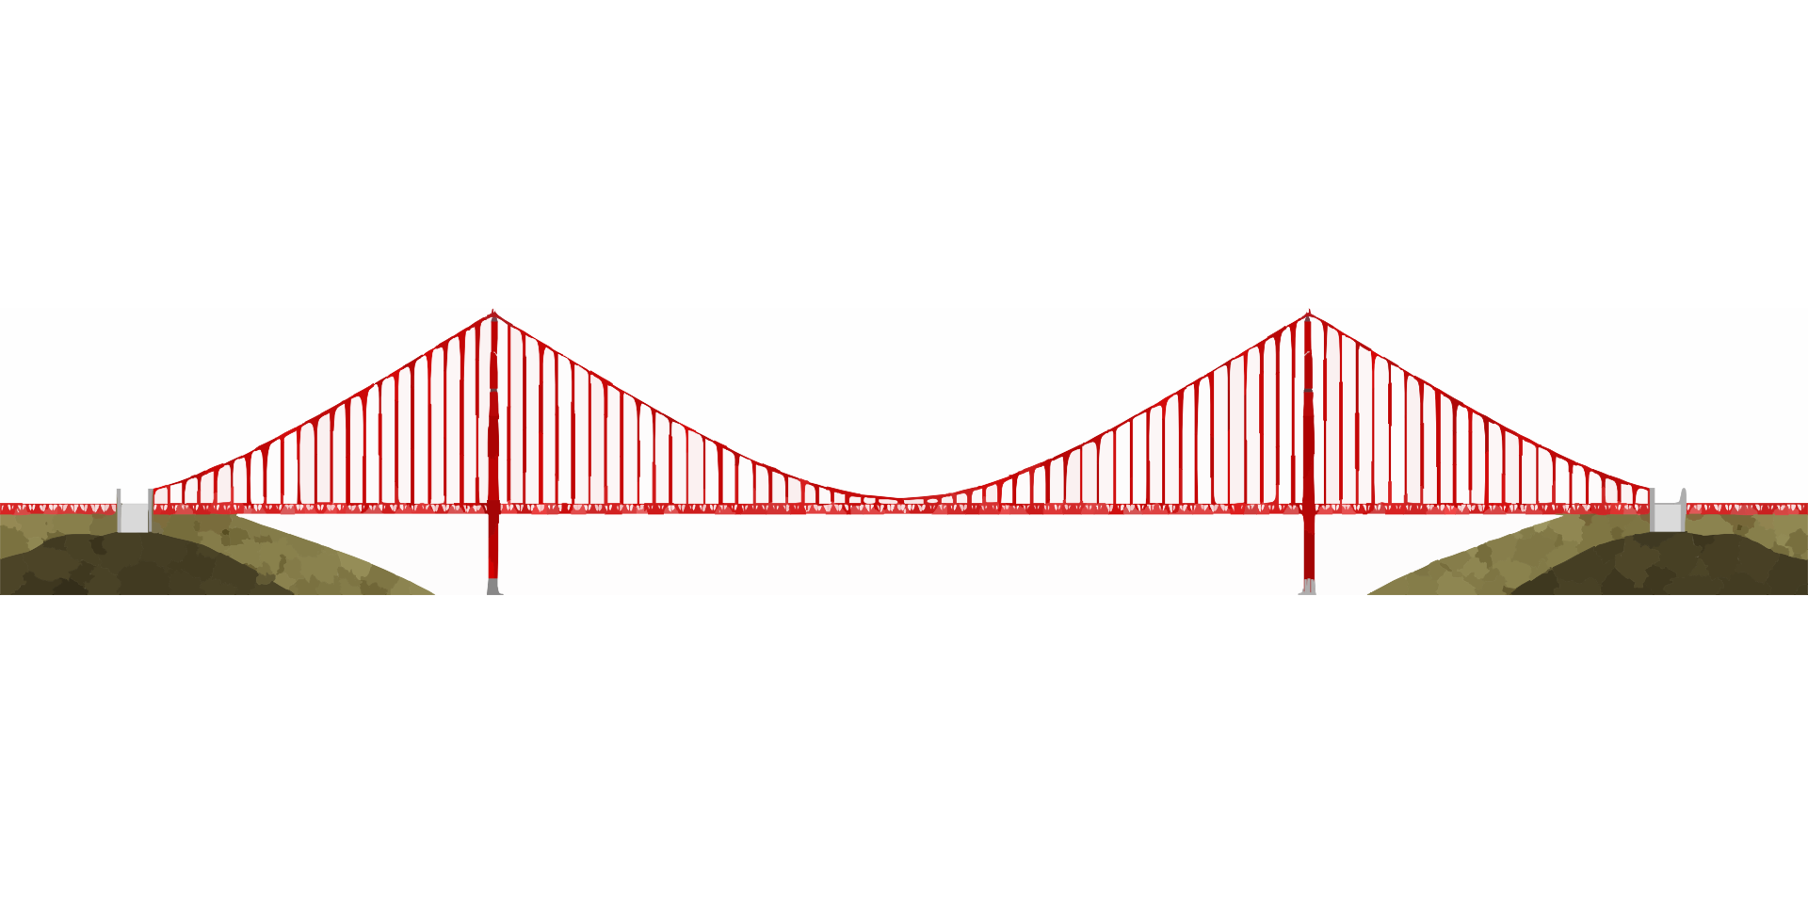
Ideas on Learning Revisited
How do people learn?
What changed?
What didn’t?
3 Words
2 Questions
1 Analogy or Metaphor
Notes:
Image credits:
https://pixabay.com/en/golden-gate-bridge-bridge-294532/

Slide 24
Analogy & Metaphor
Analogy
a comparison in which an idea or a thing is compared to another thing that is quite different from it.
“explains” that idea or thing by comparing it to something that is familiar.
Example: How a doctor diagnoses diseases is like how a detective investigates crimes.
Metaphor
a figure of speech that makes an implicit, implied, or hidden comparison between two things that are unrelated but share some common characteristics.
a resemblance between two contradictory or different objects is made based on one or more common characteristics.
Example: It’ll be clear sailing from now on. (This implies that clear sailing augurs well; the future will be without hardships).

Slide 25
Turn & Talk
Ideas on Learning Revisited
What changes did you make or not make?
What prompted the changes? What made changes unnecessary?
How has your thinking about how people learn evolved and/or deepened?
What change or two will you make in your practice to apply ideas and revelations from today’s discussion?
Notes:
Image credit: https://pixabay.com/en/chat-discussion-meeting-talk-23713/

